Slide 1
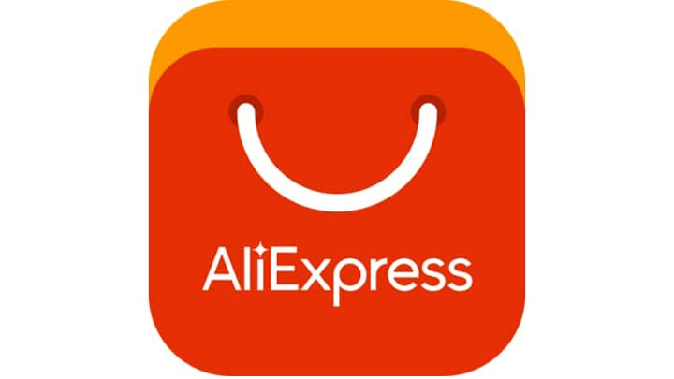

Web Application Testing - AliExpress
Final Project – Dezsi Janos

Slide 2
AliExpress
What is Aliexpress?
AliExpress is an ecommerce platform made up from individuals and companies based in China, owned by Alibaba Group. Launched in 2010, that offer products to international online shoppers.
How it works?
works exactly like all the other generalist platforms that deal with online product sales.
articles are divided into different categories and divisions.
Who Sells on AliExpress and How?
Sellers on AliExpress are all located in China and other locations, such as Singapore and are each issued a unique store number.
What to Buy?
products manufactured in China.
choice of products is almost endless.

Slide 3

TOOLS USED
Mantis Bug Tracker – Bug Reporting
TestLink – Test Case Management
Mailinator, TempMail – Test Emails
Xmind Tool – Mind Maps
X-Ray - Exploratory Testing
BrowserStack,VPN- Compatibility and Localization Testing
Postman – Automated testing

Slide 4

TESTING APPROACH
Defined the requirements
Ad-hoc testing
Exploratory Testing (documented, defects were reported in Mantis)
Component Testing
Integration Testing
System integration Testing
Negative Testing
Smoke test: created and executed in TestLink
Compatibility and Localization testing (BrowserStack and VPN)
UI testing (Visual Code) and API testing (Postman)

Slide 5
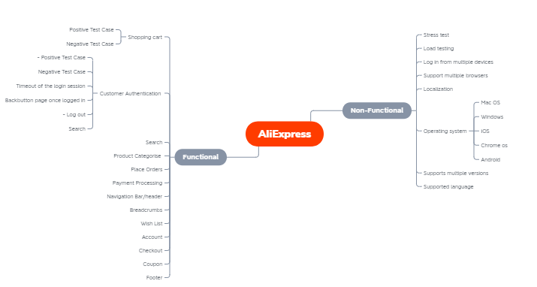
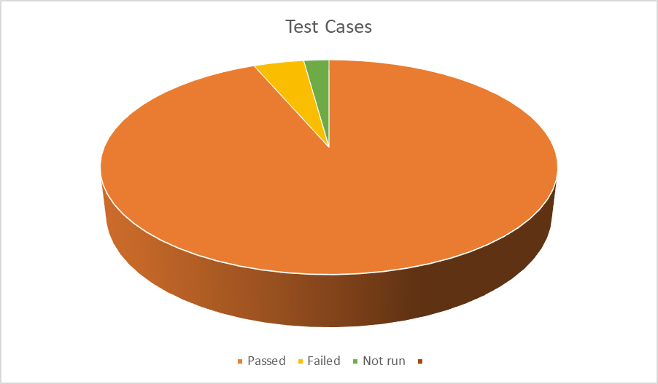
Smoke Testing
Total: 94 Test Cases
94 test cases
93.61% passed
4.25% failed
2.13% not run
Created in TestLink

Slide 6
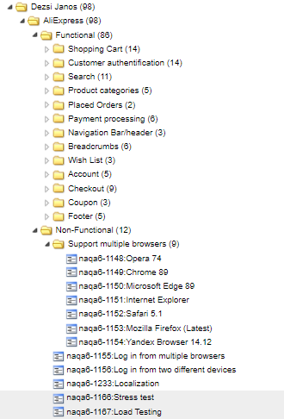
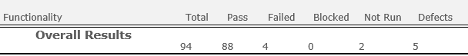
Test case Results
Created in TestLink
The structure was made based on the mind map
Executed manually

Slide 7
Exploratory Testing
5 bugs found (4 categories) with the ID:, 31539 and 0031911;
31899; 0032025; 0031925;
2 improvements: 0031831,
0031924.
Made with X-Ray - Exploratory Testing and TestLink.

Slide 8

TESTING TYPES
Performed test
Applicable test
Functional Testing
Exploratory Testing
Negative Testing
Positive Testing
Smoke Testing
Compatibility Testing
UI Testing
Usability Testing
API Testing
Performance Testing
Security Testing

Slide 9
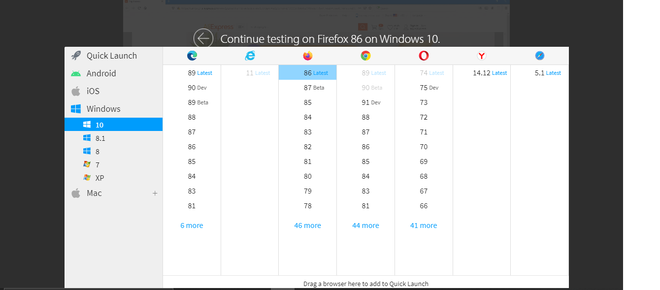
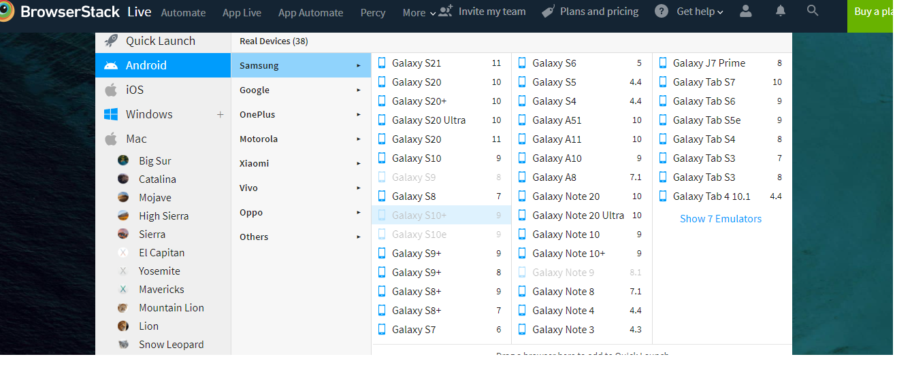
Compatibility Testing
Browsers:
Google Chrome (89, 90, 41, 88)
MS Internet Explorer 11
Microsoft Edge (89, 90DEV, 89Beta)
Yandex 14.17
Safari 5.1
OS:
Windows,
MAC
Android
iOS

Slide 10
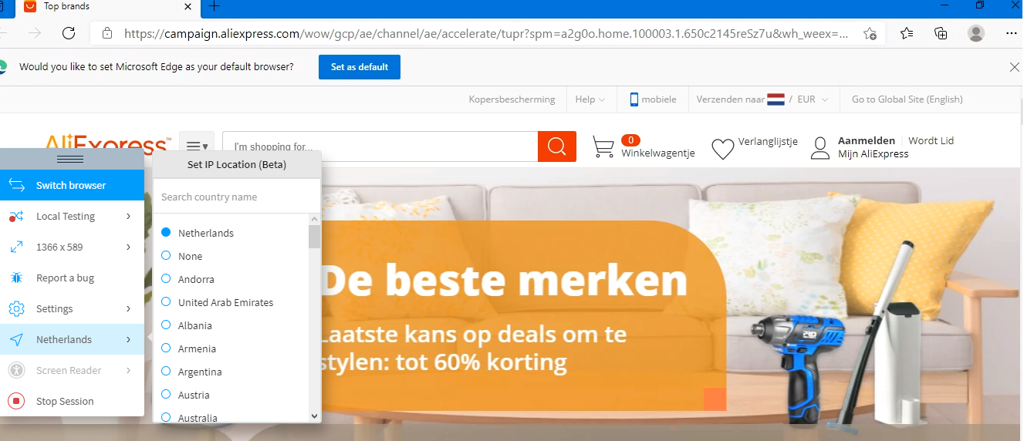
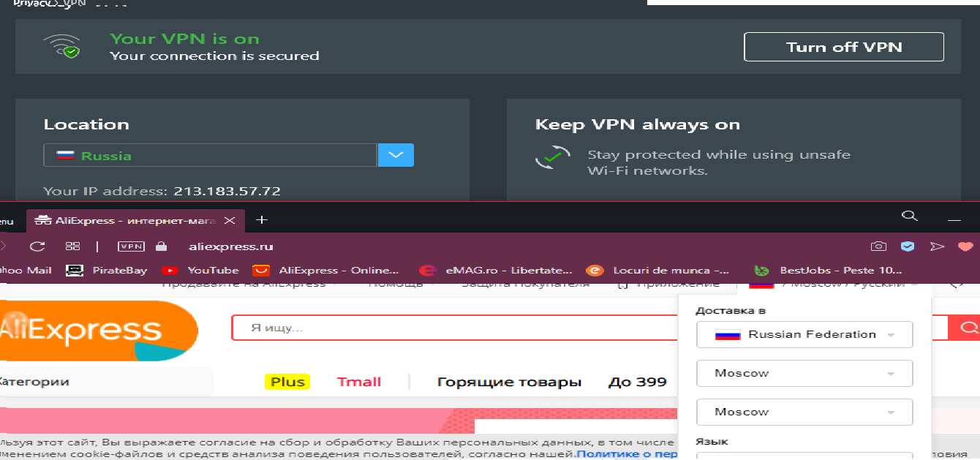
Localization Testing
AliExpress Multi-Language Sites
Search function behaves differently depending on user profile (localization, tracking, client checking cookies etc.)
Performed with BrowserStack and VPN

Slide 11
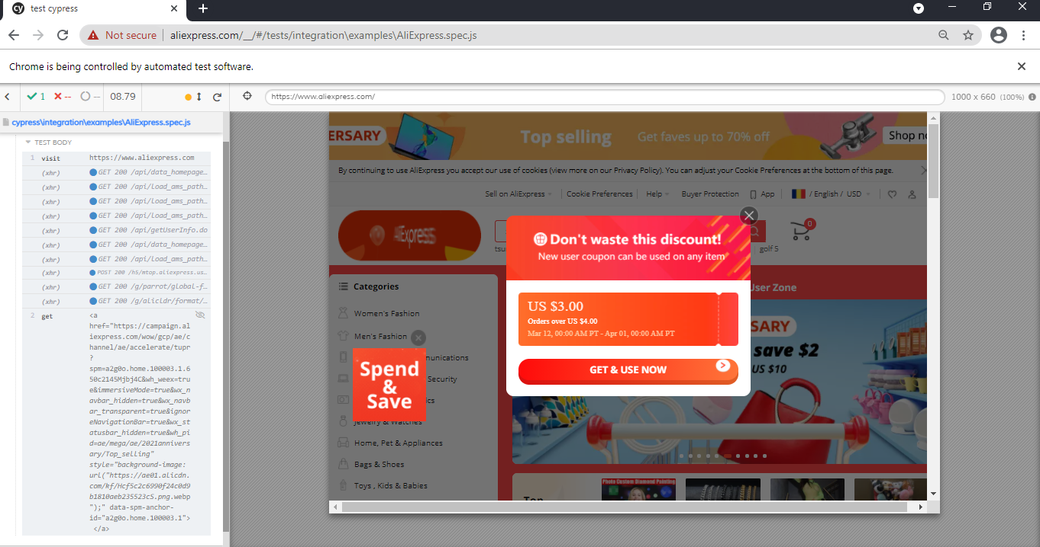
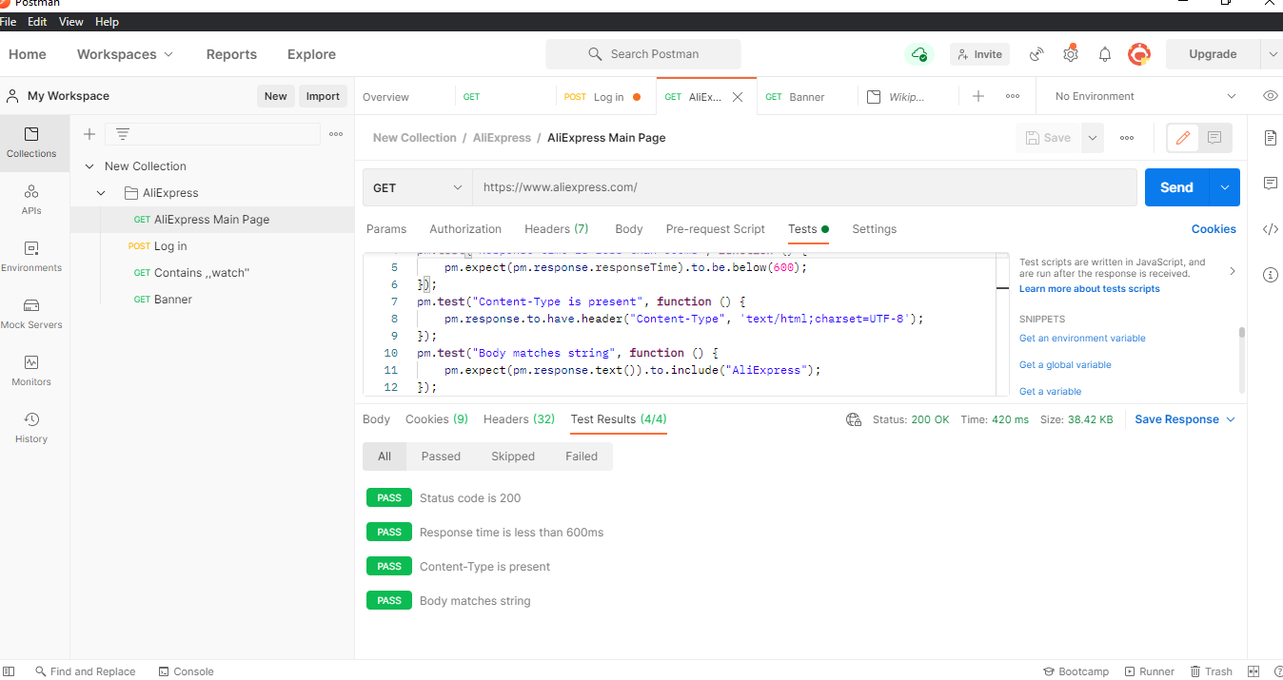
Automation Testing
UI testing made with Visual studio code (cypress), 1 TC was possible only.
API testing , with Postman.

Slide 12

Conclusions
94 test cases were run
5 bugs identified during Exploratory Testing and Smoke Test.
Data type used during testing: Blank, Valid, Invalid, Big Data
Fixing the major and medium severity bugs is highly recommended
Application behaves differently, depending on user's localization, cookies
AliExpress works good on the different OS’s and browsers

Slide 13

LESSONS LEARNED
Lack of requirements
Exploratory Testing facilitates learning of functionalities and can be time saving
Access to the site can be restricted, message 403 Forbidden
Finding bugs was difficult, but they exists
There are many tools that help us save time and effort
It is very important to use simple steps for reporting (test cases or bugs)
Early testing is very important
Smaller application for first testing

Slide 14
LESSONS LEARNED
Challenges
Lack of requirements
Access to the site can be restricted, message 403 Forbidden
Lessons
Exploratory Testing facilitates learning of functionalities and can be time saving.
There are many tools that help us save time and effort
Finding bugs was difficult, but they exists
It is very important to use simple steps for reporting (test cases or bugs)
Early testing is very important
Smaller application for first testing

Slide 15

THANK You
‘’Software testers are the unsung heroes of the software development life cycle.’’
-Maged Koshty

